Slide 1
Azure Storage Services
Notes:
Learn learning path: https://docs.microsoft.com/learn/paths/azure-fundamentals-describe-azure-architecture-services/

Slide 2
Storage - Objective Domain
Describe the benefits and usage of:
Compare Azure storage services.
Describe storage tiers.
Describe redundancy options.
Describe storage account options and storage types.
Identify options for moving files, including AzCopy, Azure Storage Explorer, and Azure File Sync.
Describe migration options, including Azure Migrate and Azure Data Box.
Notes:
https://docs.microsoft.com/learn/modules/describe-azure-storage-services/1-introduction

Slide 3

Storage accounts
Must have a globally unique name
Provide over-the-internet access worldwide
Determine storage services and redundancy options
Notes:
https://docs.microsoft.com/learn/modules/describe-azure-storage-services/2-accounts

Slide 4
Storage redundancy
Redundancy configuration | Deployment | Durability
Locally redundant storage (LRS) | Single datacenter in the primary region | 11 nines
Zone-redundant storage (ZRS) | Three availability zones in the primary region | 12 nines
Geo-redundant storage (GRS) | Single datacenter in the primary and secondary region | 16 nines
Geo-zone-redundant-storage (GZRS) | Three availability zones in the primary region and a single datacenter in secondary region | 16 nines
Cloud Storage has been designed for at least 99.999999999% annual durability, or 11 nines. That means that even with one billion objects, you would likely go a hundred years without losing a single one!
Notes:
https://docs.microsoft.com/learn/modules/describe-azure-storage-services/3-redundancy

Slide 5
Determine Storage Account Kinds
Storage Account | Recommended usage
Standard general-purpose v2 | Most scenarios including Blob, File, Queue, Table, and Data Lake Storage.
Premium block blobs | Block blob scenarios with high transactions rates, or scenarios that use smaller objects or require consistently low storage latency.
Premium file shares | Enterprise or high-performance file share applications.
Premium page blobs | Premium high-performance page blob scenarios.
✓
All storage accounts are encrypted using Storage Service Encryption (SSE) for data at rest
Notes:
Storage account overview - https://docs.microsoft.com/azure/storage/common/storage-account-overview
Create an Azure Storage account - https://docs.microsoft.com/azure/storage/common/storage-account-create
Upgrade to a general-purpose v2 storage account - https://docs.microsoft.com/azure/storage/common/storage-account-upgrade
Create an Azure Storage account - https://docs.microsoft.com/learn/modules/create-azure-storage-account/

Slide 6
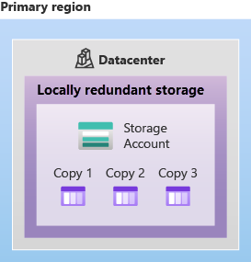
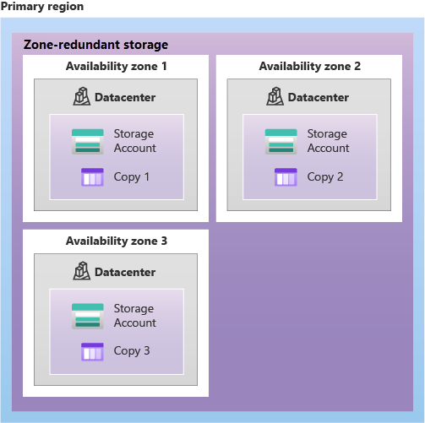
Storage Redundancy – LRS & ZRS

Slide 7
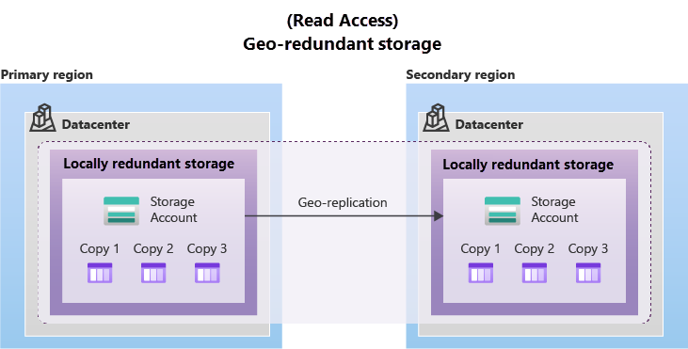
Storage Redundancy – GRS

Slide 8
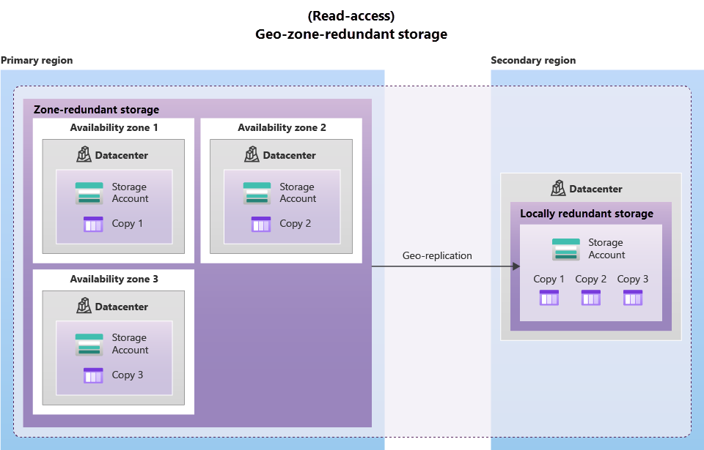
Storage Redundancy – GZRS (RA-GRS/RA-GZRS)

Slide 9
Determine Replication Strategies (1 of 2)
Single region
Multiple regions
Typically, >300mi
Typically, >300mi
Z1
Async
Async
Z2
Z3
Primary
Secondary
Primary
Secondary
LRS
Three replicas, one region
Protects against disk, node, rack failures
Write is acknowledged when all replicas are committed
Superior to dual-parity RAID
ZRS
Three replicas, three zones, one region
Protects against disk, node, rack, and zone failures
Synchronous writes to all three zones
GRS
Six replicas, two regions (three per region)
Protects against major regional disasters
Asynchronous copy to secondary
RA-GRS
GRS + read access to secondary
Separate secondary endpoint
Recovery point objective (RPO) delay to secondary can be queried
Continued next slide
Notes:
An Azure Storage account always replicates your data to help ensure durability and high availability. Azure Storage copies data so that it’s protected from planned and unplanned events, including transient hardware failures, network or power outages, and natural disasters.
You can replicate data within the same datacenter, across zonal datacenters within the same region, or across geographically separated regions.
Locally redundant storage (LRS) replicates data three times within a single datacenter. LRS provides at least 99.999999999 (11 nines) percent durability of objects over a given year. LRS is the lowest-cost replication option, and it offers the least durability compared to other options.
Zone-redundant storage (ZRS) replicates data synchronously across three storage clusters in a single region. Each storage cluster is physically separated from the others and is in its own availability zone (AZ).
Geo-redundant storage (GRS) is designed to provide at least 99.99999999999999 (16 nines) percent durability of objects over a given year by replicating data to a secondary region that’s hundreds of miles away from the primary region.
Read-access geo-redundant storage (RA-GRS) is based on GRS. RA-GRS replicates data to another datacenter in a secondary region, and it also provides the option to read from the secondary region.

Slide 10
Determine Replication Strategies (2 of 2)
Multiple regions
Typically, >300mi
Typically, >300mi
Z1
Z1
Secondary
Secondary
Z2
Z3
Z2
Z3
Async
Async Read
GZRS
Six replicas, 3+1 zones, two regions
Protects against disk, node, rack, zone, and region failures
Synchronous writes to all three zones and asynchronous copy to secondary
RA-GZRS
GZRS + read access to secondary
Separate secondary endpoint
RPO delay to secondary can be queried
Notes:
Geographically zone-redundant storage (GZRS) combines the high availability of ZRS with the protection from regional outages that GRS provides. A GZRS storage account replicates data across three Azure AZs in the primary region, and to a secondary geographic region for protection from regional disasters.
Optionally, you can enable read access to data in the secondary region with read-access geographically zone-redundant storage (RA-GZRS) if your applications must read data in the event of a disaster in the primary region.

Slide 11



Azure storage services
Container storage (blob) is optimized for storing massive amounts of unstructured data, such as text or binary data.
Disk storage provides disks for virtual machines, applications, and other services to access and use.
Azure Files sets up a highly available network file shares that can be accessed by using the standard Server Message Block (SMB) protocol.
Notes:
https://docs.microsoft.com/learn/modules/describe-azure-storage-services/4-describe-azure-storage-services

Slide 12
Compare Files to Blobs
Feature | Description | When to use
Azure Files | SMB interface, client libraries, and a REST interface that allows access from anywhere to stored files | Lift and shift an application to the cloud Store shared data across multiple virtual machines Store development and debugging tools that need to be accessed from many virtual machines
Azure Blobs | Client libraries and a REST interface that allows unstructured data (flat namespace) to be stored and accessed at a massive scale in block blobs | Support streaming and random-access scenarios Access application data from anywhere
Notes:
Extra slide at the end for NetApp Files if you want to cover that.
What is Azure Files? - https://docs.microsoft.com/azure/storage/files/storage-files-introduction
✔️ When selecting which storage feature to use, you should also consider pricing.

Slide 13
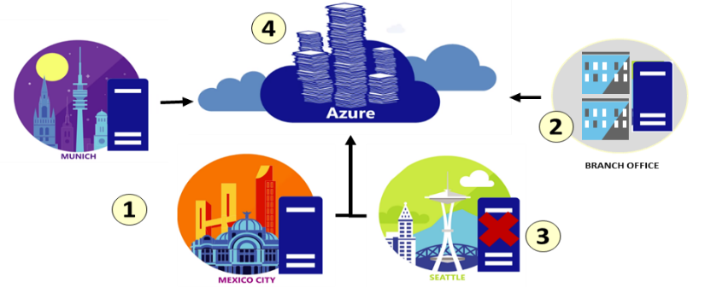
Implement Azure File Sync
Centralize your organization's file shares in Azure Files, while keeping the flexibility, performance, and compatibility of an on-premises file server
Lift and shift
Branch Office backups
Backup and Disaster Recovery
File Archiving
Notes:
Planning for an Azure File Sync deployment - https://docs.microsoft.com/azure/storage/files/storage-sync-files-planning
✔️ Cloud tiering is an optional feature of Azure File Sync in which frequently accessed files are cached locally on the server while all other files are tiered to Azure Files based on policy settings.

Slide 14



Azure storage access tiers
Hot | Cool | Archive
Optimized for storing data that is accessed frequently. | Optimized for storing data that is infrequently accessed and stored for at least 30 days. | Optimized for storing data that is rarely accessed and stored for at least 180 days with flexible latency requirements.
You can switch between these access tiers at any time.
Notes:
https://docs.microsoft.com/learn/modules/describe-azure-storage-services/4-describe-azure-storage-services

Slide 15
File management options
AzCopy
Azure Storage Explorer
Azure File Sync
Command line utility
Graphical user interface
(similar to Windows Explorer)
Synchronizes Azure and on premises files in a bidirectional manner
Copy blobs or files to or from your storage account
Compatible with Windows, MacOS, and Linux
Cloud tiering keeps frequently accessed files local, while freeing up space
One-direction synchronization
Uses AzCopy to handle file operations
Rapid reprovisioning of failed local server (install and resync)
Notes:
https://docs.microsoft.com/learn/modules/describe-azure-storage-services/7-identify-azure-file-movement-options

